Slide 1
DBMS
EER Features

Slide 2
EER
An ER diagram gives you the visual outlook of your database. It details the relationships and attributes of its entities, paving the way for smooth database development in the steps ahead.
EER diagrams, on the other hand, are perfect for taking a more detailed look at your information.
When your database contains a larger amount of data and difficult to use the traditional ER model for database modeling so it is best to turn to an enhanced model to more deeply understand your model.

Slide 3
Enhanced entity-relationship diagrams are advanced database diagrams very similar to regular ER diagrams which represents requirements and complexities of complex databases.
It is a diagrammatic technique for displaying the Sub Class and Super Class; Specialization and Generalization; Union or Category; Aggregation etc.(Additional features)

Slide 4
Used to model the application more accurately and more precisely.

Slide 5
Subclass/Superclass
An entity type may have additional meaningful subgroupings of its entities that need to be represented explicitly because of their significance to the database application.
These subgroupings of an entity are called subclass of the entity.
The entity itself is called the superclass.

Slide 6
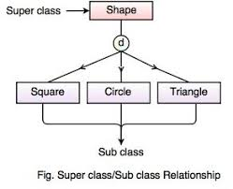

Slide 7
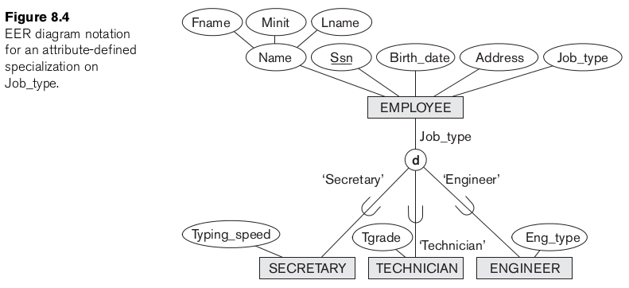

Slide 8
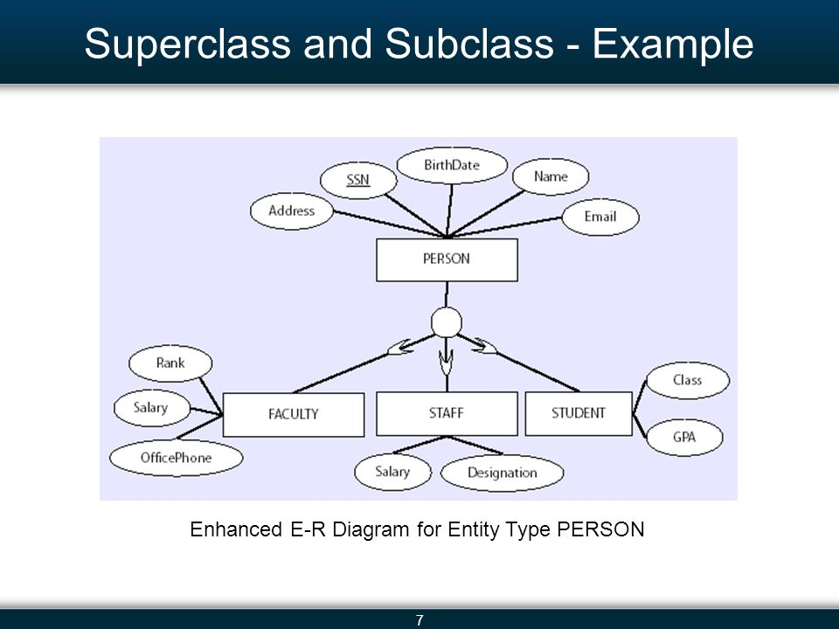

Slide 9
Specialization
The process of classifying an entity into more specialized entity.
Convert high level entity into low level entity by adding additional attribute or special attribute.
Top down approach of superclass/ subclass relationship.

Slide 10
Low level entity inherits all attributes of higher entity attribute
Entity is divided into sub entity.
Added some special attribute,feature

Slide 11
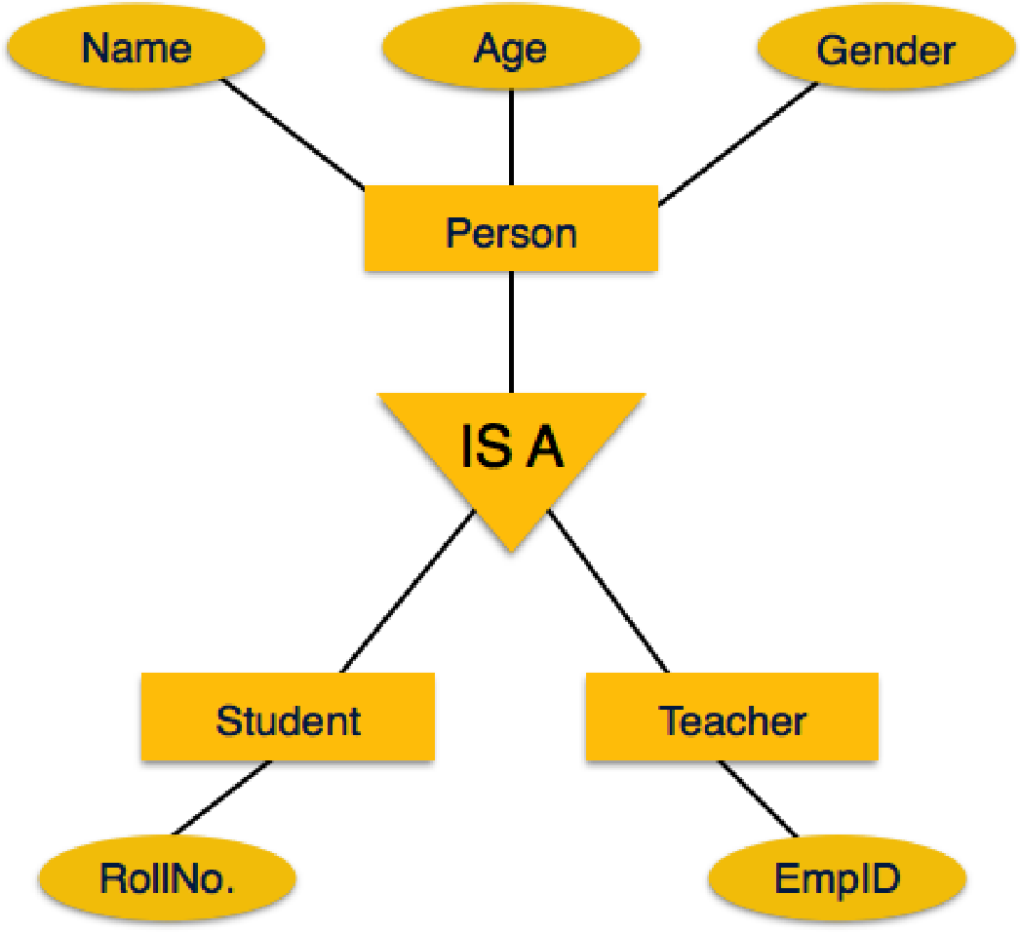
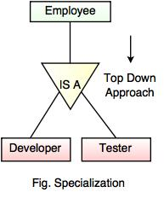
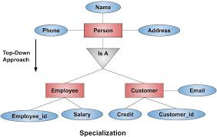

Slide 12
Generalization
Reverse of specialization.
It is a bottom up approach.
Common attribute of more than one entity form a new entity.
Lower level attribute unite and produce higher level attribute
Both diagrams are same

Slide 13
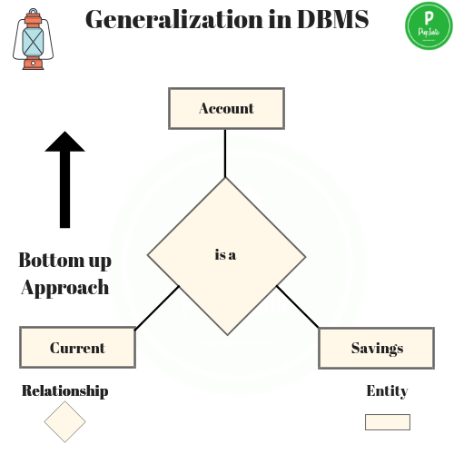

Slide 14
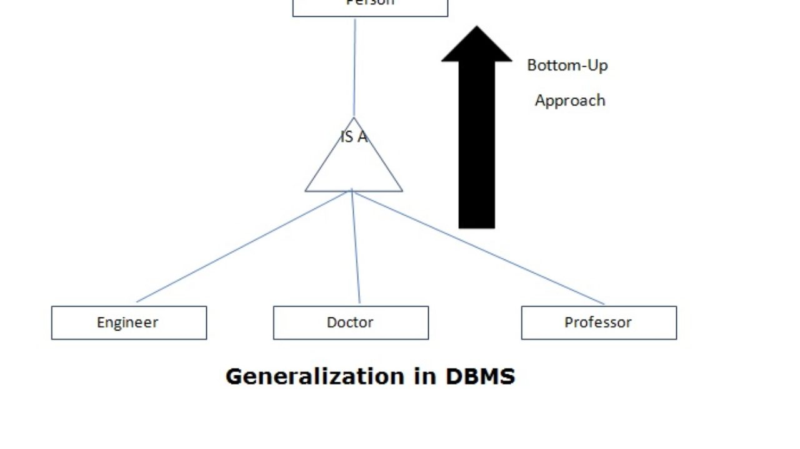

Slide 15
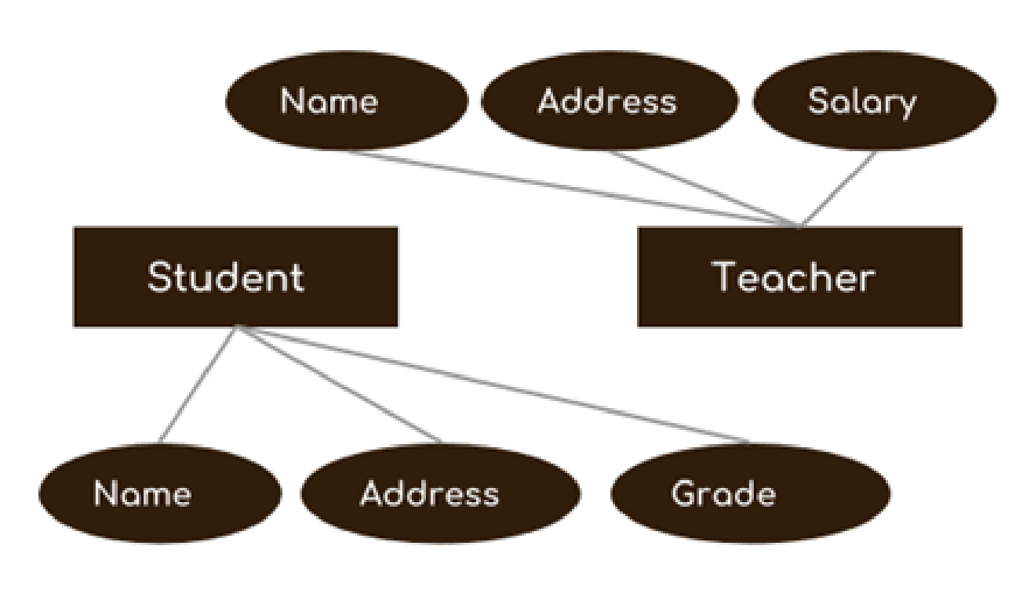
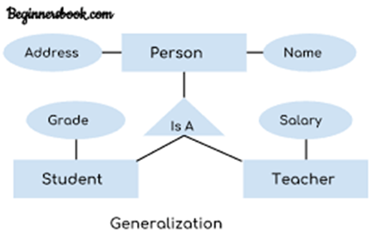
Before and after Generalization

Slide 16
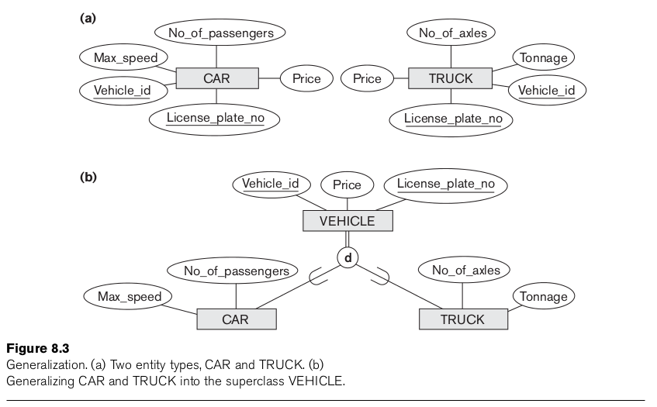

Slide 17
Aggregation
It is an relation between two entity treated as a single entity.
It is an abstraction through which relationship is treated as higher level entities.
Limitation of ER diagram is we can not represent relationship among relationship.

Slide 18
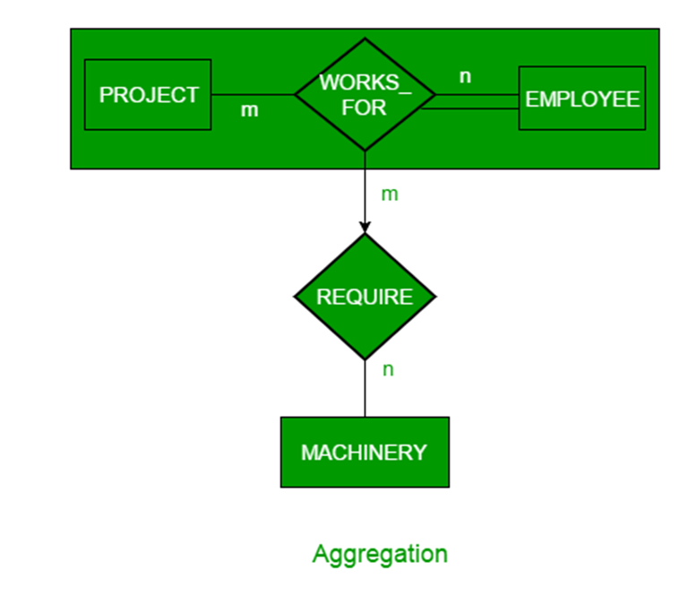
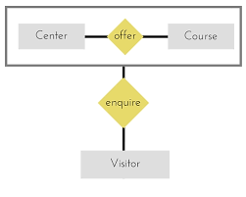
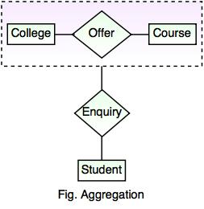

Slide 19
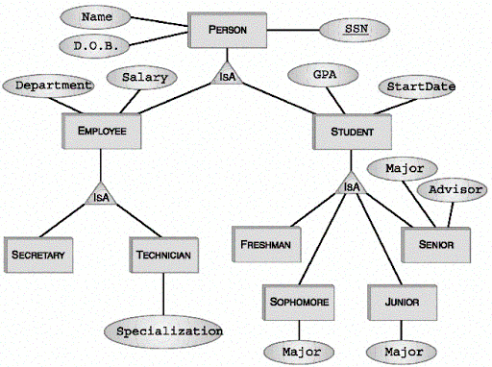

Slide 20
Thank you !
‹#›

